Slide 1

History as Inquiry
Causation/Chronology
Counterfactual History
Historiography
13 March 2013

Slide 2

Objectives
Develop a practical approach for understanding historical causation
Discuss the relationship between causation and chronology
Evaluate the utility of counterfactual history
Use historiography to analyze perspectives in secondary sources

Slide 3
Causation
Content Statement
4. Historians analyze cause, effect, sequence, and correlation in historical events, including multiple causation and long- and short-term causal relations.
Content Elaborations
When studying a historical event or person in history, historians analyze cause and effect relationships. …
Expectations for Learning
Identify examples of multiple causation and long- and short-term causal relationships with respect to historical events.
Analyze the relationship between historical events taking into consideration cause, effect, sequence and correlation.
-Ohio’s New Learning Standards: K-12 Social Studies

Slide 4
Causation
Common Core – ELA – Literacy in History/Social Studies – Grades 9 – 10
CCSS.ELA-Literacy.RH.9-10.3 Analyze in detail a series of events described in a text; determine whether earlier events caused later ones or simply preceded them.

Slide 5
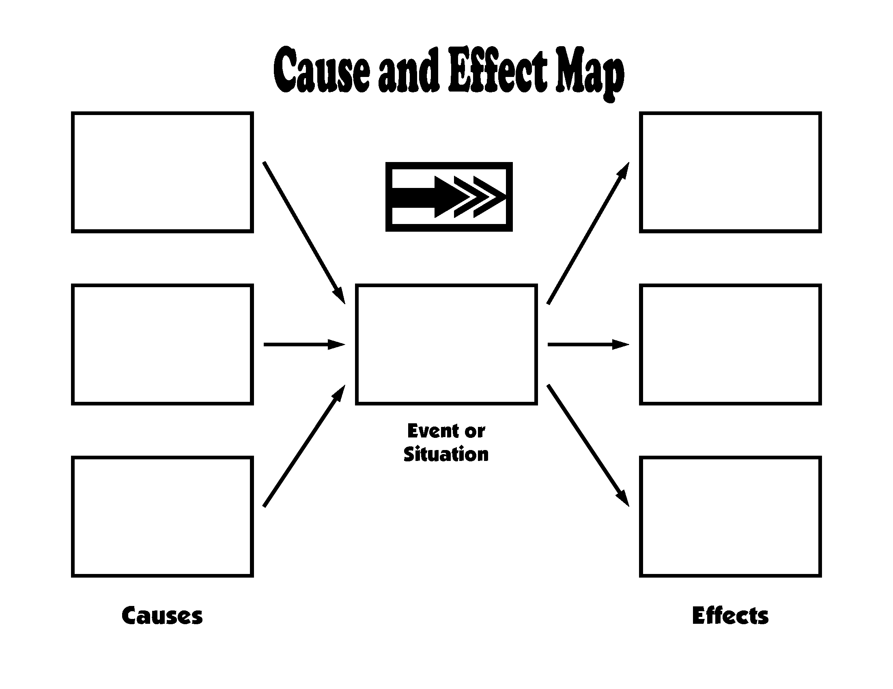
Causation
Accept, Reject, or Revise the following thesis:
Graphic Organizers like the one on this page are an effective tool for helping students analyze historical causation.

Slide 6
Causation
The Case of Billy Elliot: The Challenge of Pinning Down Causes
Approaches
  Chaos Theory
  Determinism
Historians
  Whig Historians
  Annales Historians
  Marxist Historians
A Practical Approach

Slide 7
Causation
Chronology and Causation (Lesh, Chapter 4)
  Content or Process?
  How do time lines “disguise the true nature of the past”? (p. 77)
  How does Lesh’s Rail Strike of 1877 activity help students master chronological thinking?

Slide 8



Causation and Chronology
http://www.timetoast.com/

Slide 9
Alternative Courses of Action
Historical Thinking and Skills
Content Statement
1. Historical events provide opportunities to examine alternative courses of action.
Content Elaboration
By examining alternative courses of action, students can consider the possible consequences and outcomes of moments in history. It also allows them to appreciate the decisions of some individuals and the actions of some groups without putting 21st century values and interpretations on historic events. How might the history of the United States be different if the participants in historical events had taken different courses of action?
Expectations for Learning
Analyze a historical decision and predict the possible consequences of alternative courses of action.
-Ohio’s New Learning Standards: K-12 Social Studies

Slide 10
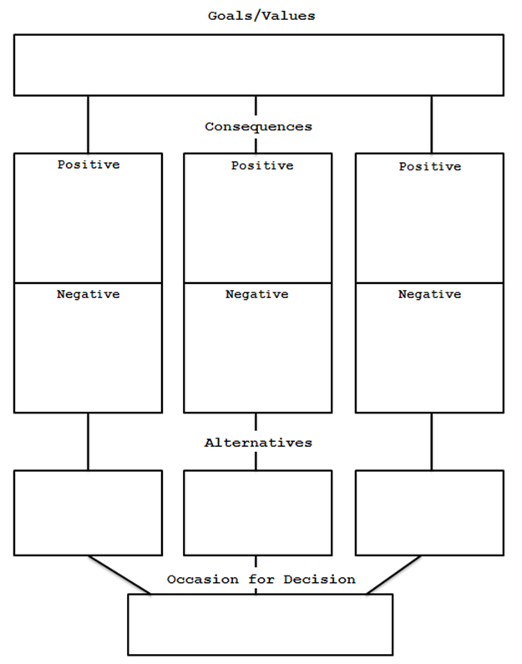
Alternative Courses of Action
Decision Tree

Slide 11
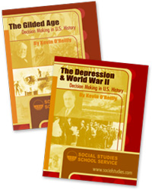
Alternative Courses of Action
Foresight History - Decision-Making Analysis
  PAGE Analysis

Slide 12

Alternative Courses of Action
http://www.halfbakedsoftware.com/quandary.php
Quandary is an application for creating Web-based Action Mazes. An Action Maze is a kind of interactive case-study; the user is presented with a situation, and a number of choices as to a course of action to deal with it. On choosing one of the options, the resulting situation is then presented, again with a set of options. Working through this branching tree is like negotiating a maze, hence the name "Action Maze". Action mazes can be used for many purposes, including problem-solving, diagnosis, procedural training, and surveys/questionnaires. Example exercises

Slide 13
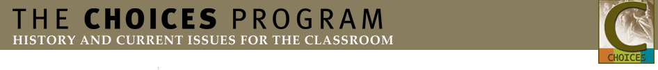
Alternative Courses of Action
The Past as Contested – Choices Program
www.choices.edu
Notes:
http://choices.edu/resources/tools.php

Slide 14
Alternative Courses of Action
Counterfactual History – “Using Counterfactual History to Enhance Students’ Historical Understanding”
  Why use counterfactual history?
  What are the strengths of weaknesses of current counterfactual sources for classroom use?
  How is Scott Roberts’ approach different than other uses of counterfactual history?
  What do you like/dislike about Roberts’ approach?
  What are the limitations of Counterfactual history?

Slide 15

Historiography
What is historiography?
How is historiography different than history?
Why teach historiography?
http://www.youtube.com/watch?v=pB3xb1_gp4Y

Slide 16
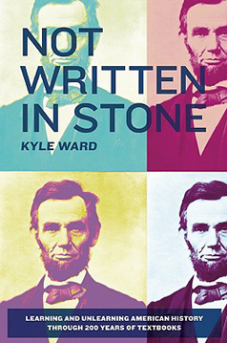
Historiography
http://www.youtube.com/watch?v=j9y34M3lb0Q

Slide 17
Historiography
Which Common Core Standards can be met using historiography?

Slide 18
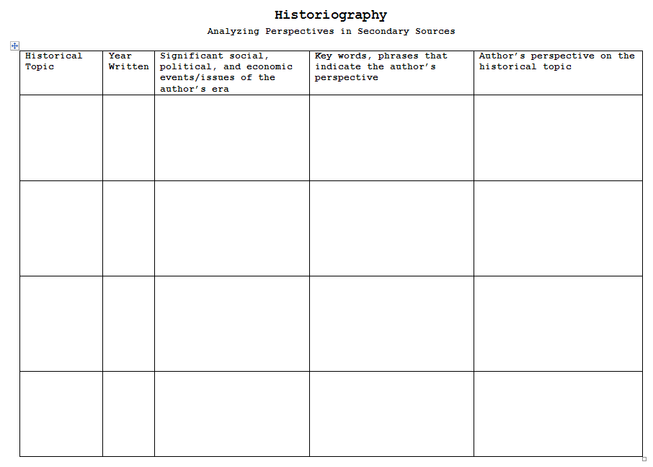
Historiography
Not Written in Stone, Kyle Ward
  Chapter 24. African Americans During Reconstruction
  Chapter 27. Immigration

Slide 19
Historiography
Cognitive Dissonance
The Fox and the Grapes
  One hot summer's day a Fox was strolling through an orchard till he came to a bunch of Grapes just ripening on a vine which had been trained over a lofty branch. "Just the thing to quench my thirst," said he. Drawing back a few paces, he took a run and a jump, and just missed the bunch. Turning round again with a One, Two, Three, he jumped up, but with no greater success. Again and again he tried after the tempting morsel, but at last had to give it up, and walked away with his nose in the air, saying: "I am sure they are sour.”
  It is easy to despise what you cannot get.

Slide 20
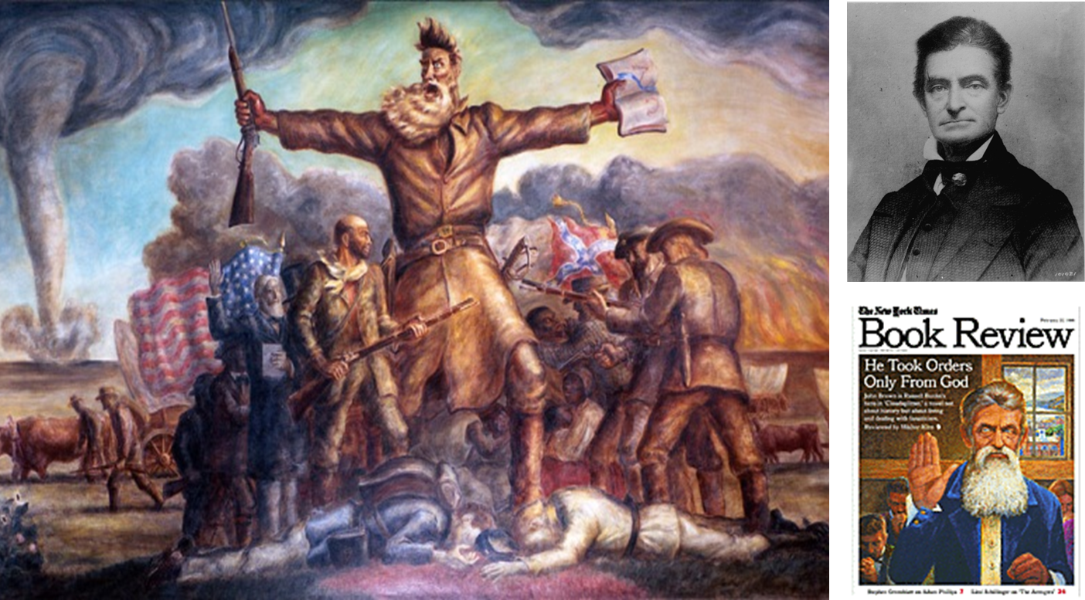
Historiography
Textbooks as Sources - Images

Slide 21
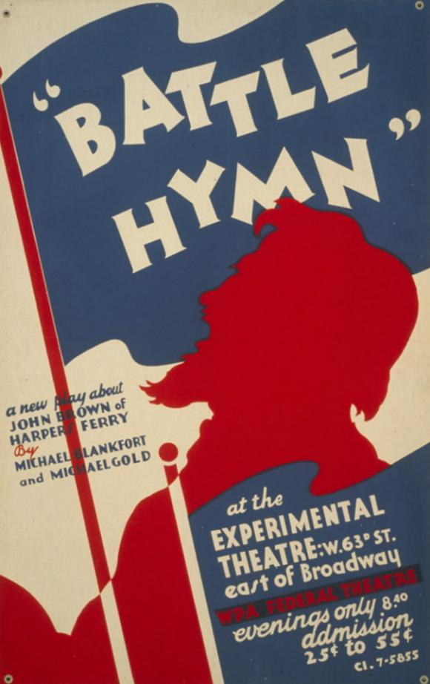

Assessing Historiography
Question 1: When was the play written?
Question 2: Which two of the facts below might help explain why the authors wrote this play?
Slaves made up nearly 40% of Virginia’s population in 1859.
One of the play’s authors, Michael Gold, was a member of the Communist Party, which protested against lynching in the 1930s.
After taking power in 1933, Adolf Hitler enacted racist policies in Germany.
After seceding from the Union in 1861, Virginia became the largest state in the Confederacy and the home of its capital, Richmond.
Source: This is a poster for a play written in 1936 that celebrates the abolitionist John Brown, who tried to start a slave revolt in Harpers Ferry, Virginia, in 1859.

Slide 22
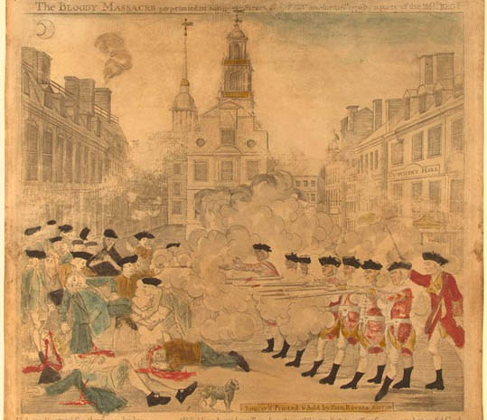
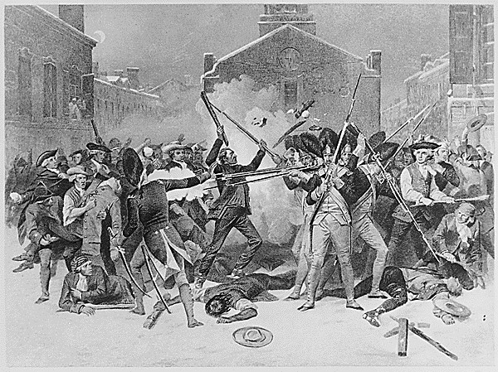
Historiography
Textbooks as Sources - Images

Slide 23
Historiography
Questioning Textbook Authority—
The Bob Bain Way
  Students build detailed knowledge through primary sources before ever opening the textbook
  Now experts, students critique the textbook: "Write a letter to the authors of the text, assessing their [authors'] representations of _____. Do you think it is an effective representation? Why or why not?"
  Students question other classroom authorities—the teacher – What biases are reflected in the teacher’s selection of sources?

